Slide 1
Health Protection Surveillance Centre
Surveillance of Zoonotic and Vectorborne disease in Ireland:
Q2 2019 provisional data
October, 2019

Slide 2
Provisional data, Q2 2019

Slide 3
Key Points – Q2 2019 zoonotic and vectorborne disease
Toxoplasmosis was the most commonly reported zoonotic disease (n=17)
Malaria was the most commonly reported vectorborne disease (n=20)
70% of malaria cases did not have country of infection reported

Slide 4
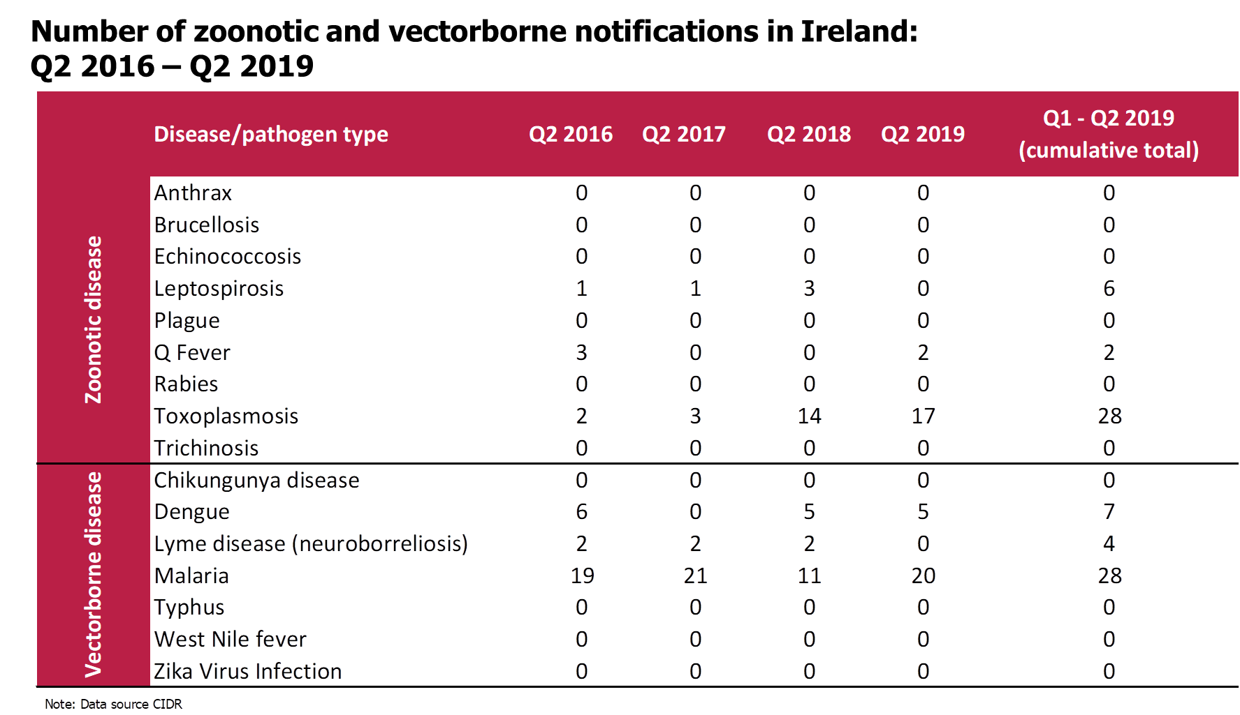

Slide 5
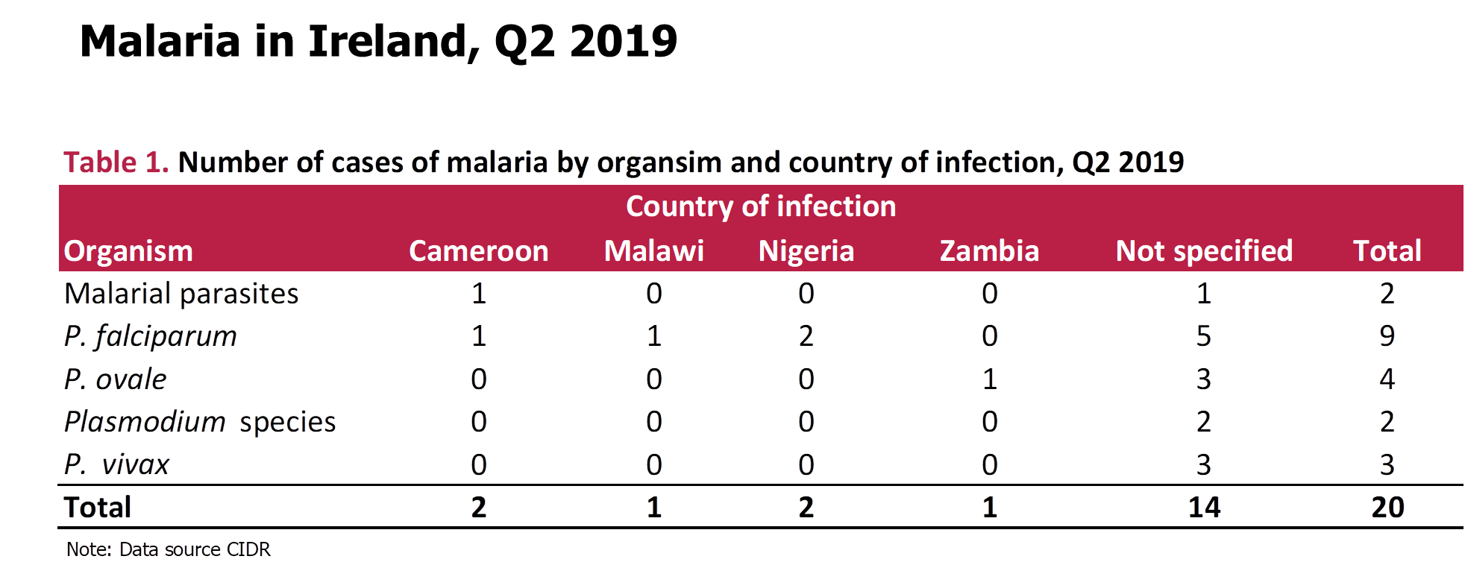

Slide 6
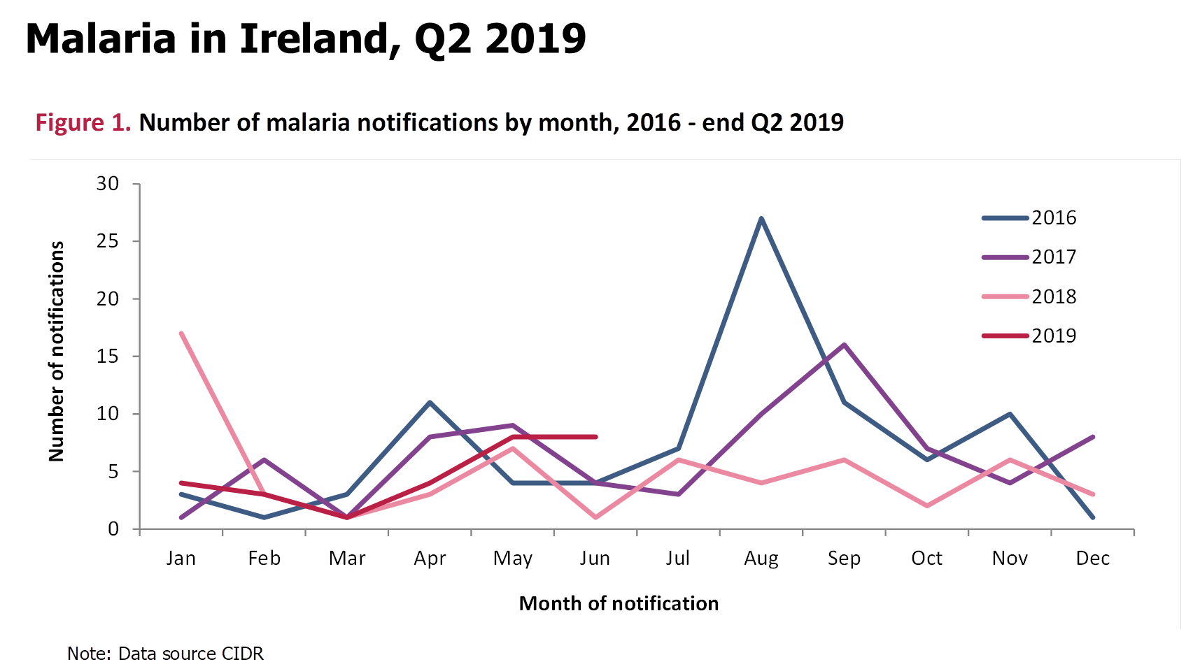

Slide 7
Further Information
Further information on Zoonotic and Vectorborne disease in Ireland can be found at
https://www.hpsc.ie/a-z/vectorborne/
https://www.hpsc.ie/a-z/zoonotic/

