Slide 1
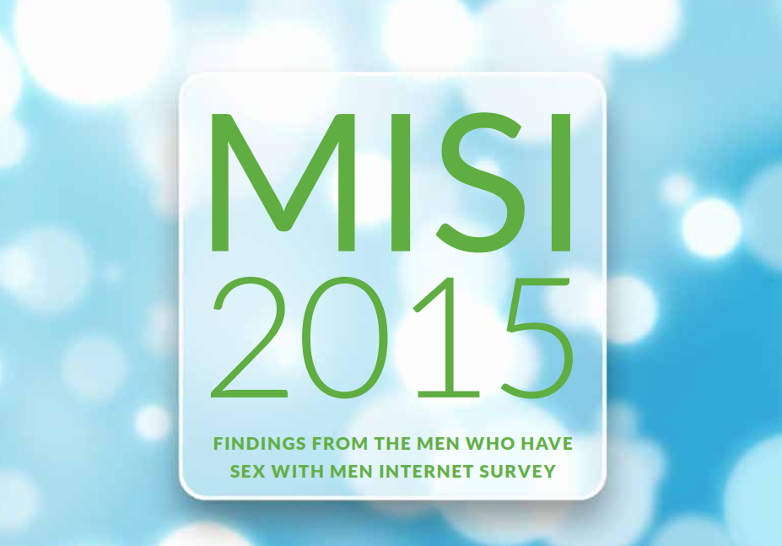
Findings from MISI 2015 (with a focus on HIV and STI testing)
Kate O’Donnell, Margaret Fitzgerald, Peter Barrett, Mick Quinlan, Derval Igoe

Slide 2
Background
Men who have sex with men (MSM) are the population most affected by HIV and STIs in Ireland
MISI 2015
Online survey of adult MSM living in Ireland
Live from March to May 2015
Questions about HIV/STI testing and infection, sexual behaviour, alcohol, drug and tobacco use, knowledge and prevention strategies

Slide 3
MISI respondents
3,090 valid responses
Aged 18-80 years
Median age: 30 years
Respondents from all 26 counties
51% living in Dublin with a further 20% from Cork, Limerick and Galway
86% Irish born, 14% born outside Ireland

Slide 4
Education level and Employment status

Slide 5
Sexual Identity
Sexual Attraction

Slide 7
Sexual behaviour

Slide 8
Sexual behaviour : Steady partners
55% of men had sex with one or more steady partners
in last 12 months

Slide 9
Sexual behaviour : Non-Steady partners
61% of men had sex with one or more non-steady partners
in last 12 months

Slide 10
HIV and STI testing and infection
 | HIV | STIs
Never tested | 37% | 38%
Did not have test in previous 12 months | 61% | 61%
Not confident accessing future test | 12% | 11%
HIV positive | 5% | -
HIV positive (among those who tested) | 8%
STI diagnosis in previous 12 months | - | 9%
STI diagnosis (among those who tested) | - | 21%

Slide 11
Never tested for HIV: univariate analysis
 | Never tested for HIV
Variable |  | % never tested | Odds Ratio | 95% CI
Age Group | 18-19 | 84.1 | 7.1 | 5.0-10
 | 20s | 42.8 | Ref | Ref
 | 30s | 22.8 | 0.40 | 0.32-0.49
 | 40s | 20.9 | 0.35 | 0.27-0.46
 | 50+ | 28.3 | 0.53 | 0.41-0.69
Education Level | High | 26.5 | Ref | Ref
 | Medium/Low | 48.8 | 2.6 | 2.3-3.1
Employment | Employed | 28.2 | Ref | Ref
 | Unemployed | 43.6 | 2.0 | 1.5-2.6
 | Student | 60.1 | 3.8 | 3.2-4.6
Sexual Identity | Gay | 31.1 | Ref | Ref
 | Bisexual/Straight/Other | 57.3 | 3.0 | 2.5-3.6

Slide 12
Never tested for HIV: univariate analysis
 | Never tested for HIV
Variable |  | % never tested | Odds Ratio | 95% CI
Age Group | 18-19 | 84.1 | 7.1 | 5.0-10
 | 20s | 42.8 | Ref | Ref
 | 30s | 22.8 | 0.40 | 0.32-0.49
 | 40s | 20.9 | 0.35 | 0.27-0.46
 | 50+ | 28.3 | 0.53 | 0.41-0.69
Education Level | High | 26.5 | Ref | Ref
 | Medium/Low | 48.8 | 2.6 | 2.3-3.1
Employment | Employed | 28.2 | Ref | Ref
 | Unemployed | 43.6 | 2.0 | 1.5-2.6
 | Student | 60.1 | 3.8 | 3.2-4.6
Sexual Identity | Gay | 31.1 | Ref | Ref
 | Bisexual/Straight/Other | 57.3 | 3.0 | 2.5-3.6

Slide 13
Never tested for HIV: univariate analysis
 | Never tested for HIV
Variable |  | % never tested | Odds Ratio | 95% CI
Age Group | 18-19 | 84.1 | 7.1 | 5.0-10
 | 20s | 42.8 | Ref | Ref
 | 30s | 22.8 | 0.40 | 0.32-0.49
 | 40s | 20.9 | 0.35 | 0.27-0.46
 | 50+ | 28.3 | 0.53 | 0.41-0.69
Education Level | High | 26.5 | Ref | Ref
 | Medium/Low | 48.8 | 2.6 | 2.3-3.1
Employment | Employed | 28.2 | Ref | Ref
 | Unemployed | 43.6 | 2.0 | 1.5-2.6
 | Student | 60.1 | 3.8 | 3.2-4.6
Sexual Identity | Gay | 31.1 | Ref | Ref
 | Bisexual/Straight/Other | 57.3 | 3.0 | 2.5-3.6

Slide 14
Never tested for HIV: univariate analysis
 | Never tested for HIV
Variable |  | % never tested | Odds Ratio | 95% CI
Age Group | 18-19 | 84.1 | 7.1 | 5.0-10
 | 20s | 42.8 | Ref | Ref
 | 30s | 22.8 | 0.40 | 0.32-0.49
 | 40s | 20.9 | 0.35 | 0.27-0.46
 | 50+ | 28.3 | 0.53 | 0.41-0.69
Education Level | High | 26.5 | Ref | Ref
 | Medium/Low | 48.8 | 2.6 | 2.3-3.1
Employment | Employed | 28.2 | Ref | Ref
 | Unemployed | 43.6 | 2.0 | 1.5-2.6
 | Student | 60.1 | 3.8 | 3.2-4.6
Sexual Identity | Gay | 31.1 | Ref | Ref
 | Bisexual/Straight/Other | 57.3 | 3.0 | 2.5-3.6

Slide 15
Never tested for HIV: univariate analysis
 | Never tested for HIV
Variable |  | % never tested | Odds Ratio | 95% CI
Age Group | 18-19 | 84.1 | 7.1 | 5.0-10
 | 20s | 42.8 | Ref | Ref
 | 30s | 22.8 | 0.40 | 0.32-0.49
 | 40s | 20.9 | 0.35 | 0.27-0.46
 | 50+ | 28.3 | 0.53 | 0.41-0.69
Education Level | High | 26.5 | Ref | Ref
 | Medium/Low | 48.8 | 2.6 | 2.3-3.1
Employment | Employed | 28.2 | Ref | Ref
 | Unemployed | 43.6 | 2.0 | 1.5-2.6
 | Student | 60.1 | 3.8 | 3.2-4.6
Sexual Identity | Gay | 31.1 | Ref | Ref
 | Bisexual/Straight/Other | 57.3 | 3.0 | 2.5-3.6

Slide 16
Settings for HIV testing

Slide 17
HIV positive men (n=152)
99% linked to care (n=150)
93% retained in care (n=141)
79% currently on ART (n=120)
91% virally suppressed (of those on ART) (n=109)

Slide 18
STI testing – details of samples/tests (self-reported)
Site of STI testing
(of those who had an STI test in the last year)
68% - STI clinic
29% - GP
3% - used other services

Slide 19
Limitations of MISI 2015
Online survey
English version only
Self reported – subject to bias
Not a representative sample
Length of survey – average 14 minutes to complete

Slide 20
Conclusions
Largest survey of MSM ever carried out in Ireland
Provides useful data for a wide variety of stakeholders, including the MSM community, policy makers and those planning and delivering HIV and STI interventions for MSM
Provides useful information on patterns of HIV and STI testing and setting for future testing

Slide 21
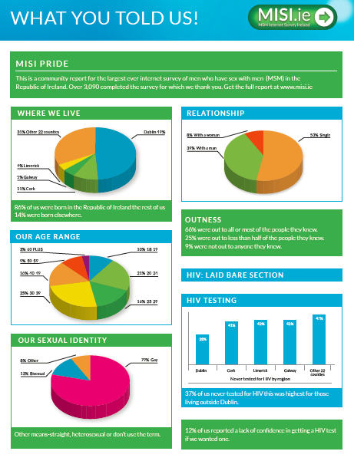
Further information – www.misi.ie

Slide 22
Thank you to…..
All of the men who completed MISI 2015
The MISI Steering Group
Derval Igoe (Chair) Margaret Fitzgerald
Peter Barrett Maeve O’Brien
Mick Quinlan Ford Hickson
Daniel McCartney Peter Keogh
Axel J Schmidt Marzena Sekular (Jun 2015-Mar 2016)
Coralie Giese (left Jan 2015)

