Slide 1
Recent increase in drug resistant shigella among gay, bisexual and other men who have sex with men (gbMSM) in Ireland: Outbreak Response
19th July 2023

Slide 2
Acknowledgements
HPSC would like to thank all those who provided the data for this slide set, particularly the National Salmonella, Shigella and Listeria Reference Laboratory (NSSLRL); STI clinics; General Practice; Other notifying physicians; Other clinical staff; Laboratories and the Departments of Public Health.
HPSC would also like to thank all members of the Shigellosis Incident Management Team
AMR infection control clinical lead: Eimear Brannigan
HIV Ireland/MPOWER: Adam Shanley
Area Public Health: Peter Barrett, Anne Sheahan, Gabriel Fitzpatrick, Christopher Carroll, Mary Ward, Fiona Cianci, Christopher Ibanga, Niall Conroy, Sarah Doyle, Mary O Mahony, Mai Mannix, Aine McNamara, Catherine Conlon, Margaret O’Sullivan
HSE Communications: Anita Butt, Maurice Kelly
HPSC: Greg Martin; Mary Archibald, Mark Campbell, Christina Dillon, Martha Neary, Angeline McIntyre, Kate O’Donnell, Derval Igoe; Aoife Colgan, Patricia Garvey, Paul McKeown
National Clinical Lead, Sexual Health, Medical Director Sexual Health and Crisis Pregnancy Programme: Fiona Lyons
National Salmonella Listeriosis and Shigella Reference Laboratory: Martin Cormican, Elaine McGrath, Mark McGuire, Wendy Brennan, Dimitar Nashev, Joanne King, Niall Delappe, Christina Clarke
National Clinical Lead, Acute Outbreak Response Programme: Una Fallon

Slide 3
Overview
Shigellosis infection is transmitted via the faecal-oral route, either through consumption of contaminated food or water or through direct person-to-person spread.
Sexual transmission among gay, bisexual and other men who have sex with men (gbMSM) is a key feature of the disease in Ireland and elsewhere.
On March 22nd 2023, HPSC issued an alert to Public Health and clinical colleagues to raise awareness of an upsurge in cases, particularly among gbMSM.
An Incident Management Team (IMT) which was convened in April 2023 continues to meet on a regular basis.
This slide set provides an update on the epidemiology and antimicrobial resistance patterns of shigellosis cases reported up to Week 22 2023.

Slide 4
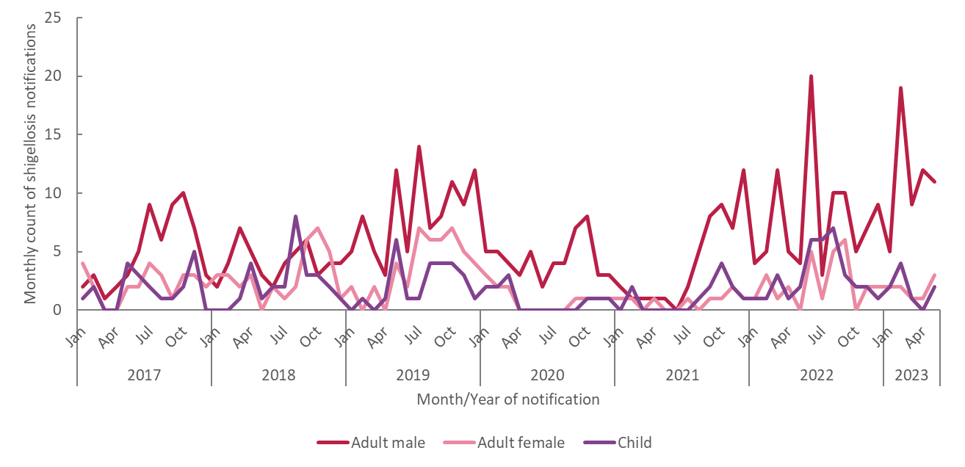
Shigellosis cases by sex and age, 2017-2023
Data source: Computerised Infectious Diseases Reporting system (CIDR)
Notes:
60% in males. In 2023, ratio of 4:1, M:F. 76% male in 2023

Slide 5
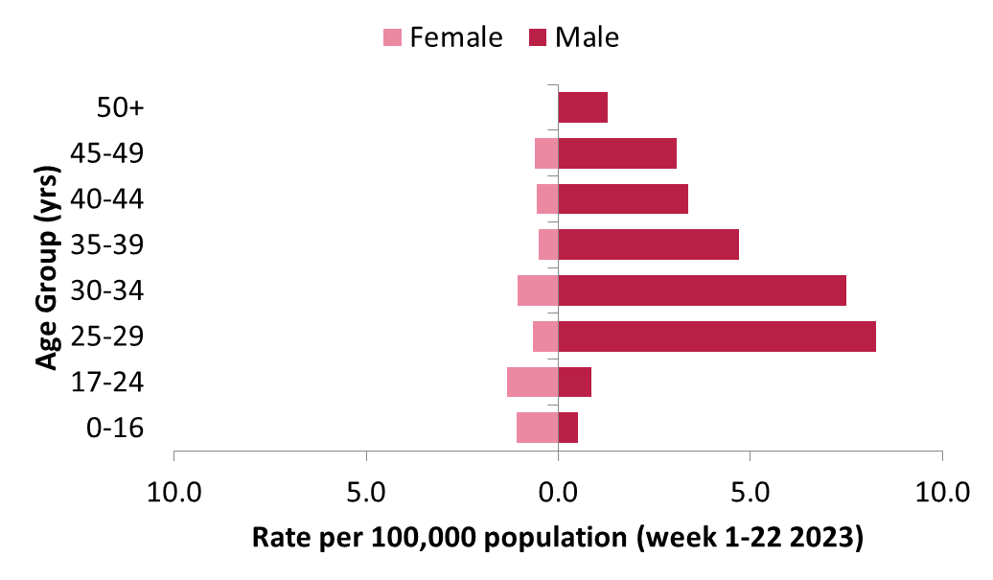
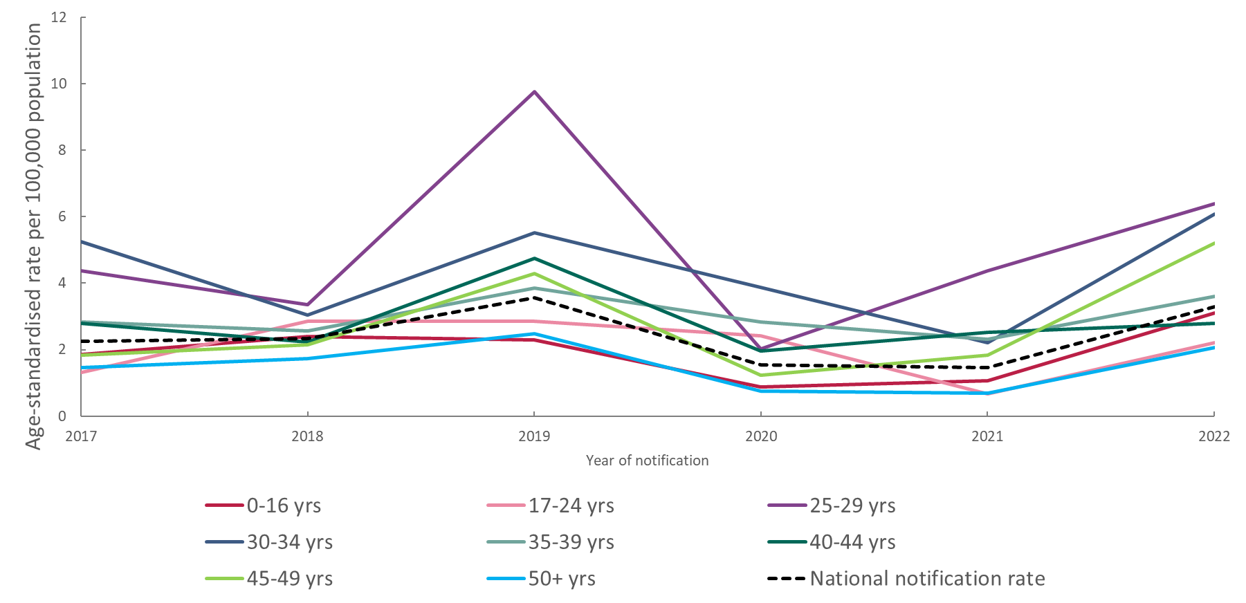
Shigellosis by Sex and Age Week 1-22, 2023 Shigellosis trends by age group, 2017-2023
Average of 28% of cases hospitalised between 2017-2022
Data source: Computerised Infectious Diseases Reporting system (CIDR)

Slide 6
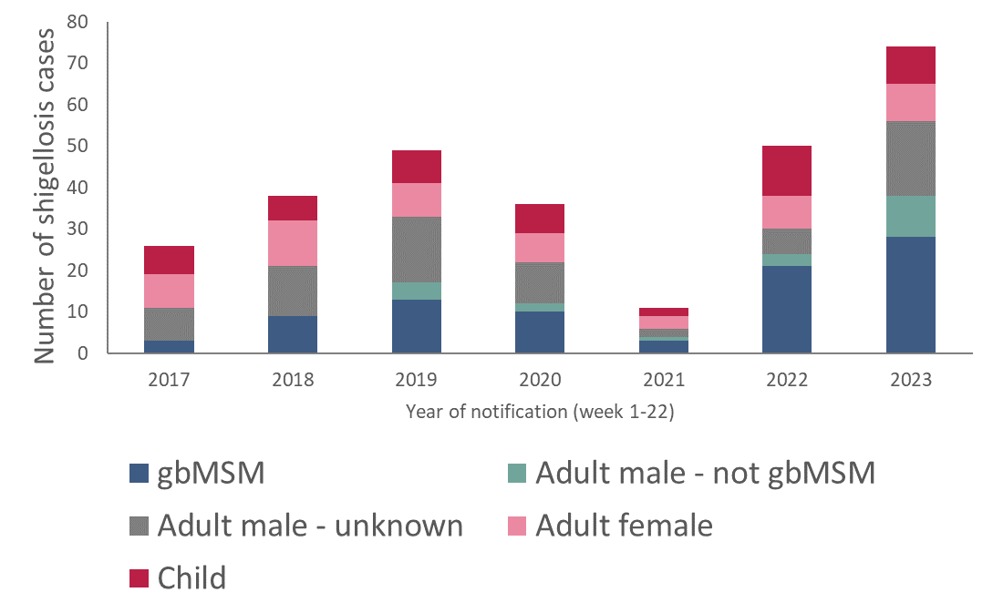
Transmission by sex, child/adult and gbMSM status Week 1-22 2017-2023
56 adult male cases
28 (50%) gbMSM
18 (32%) unknown
10 (18%) not gbMSM
Data source: Computerised Infectious Diseases Reporting system (CIDR)

Slide 7
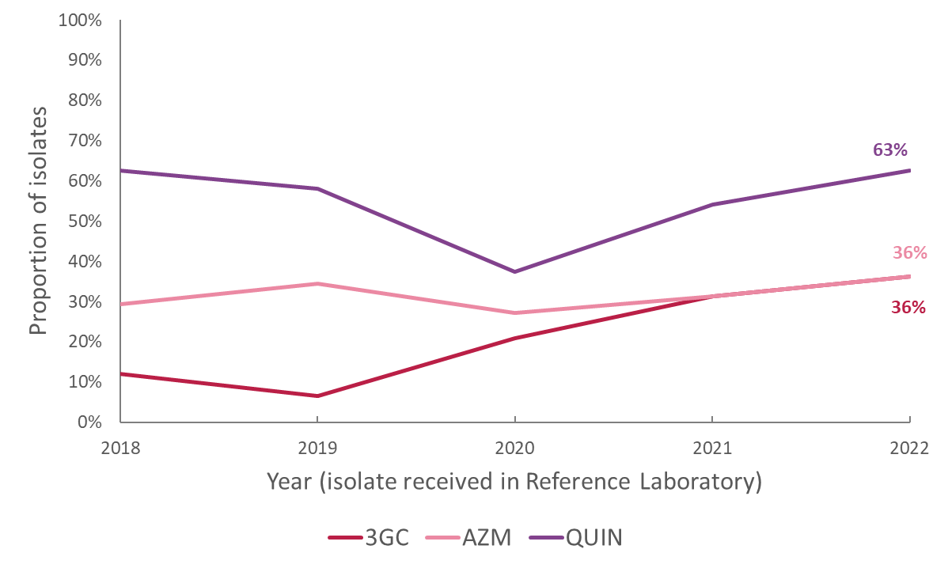
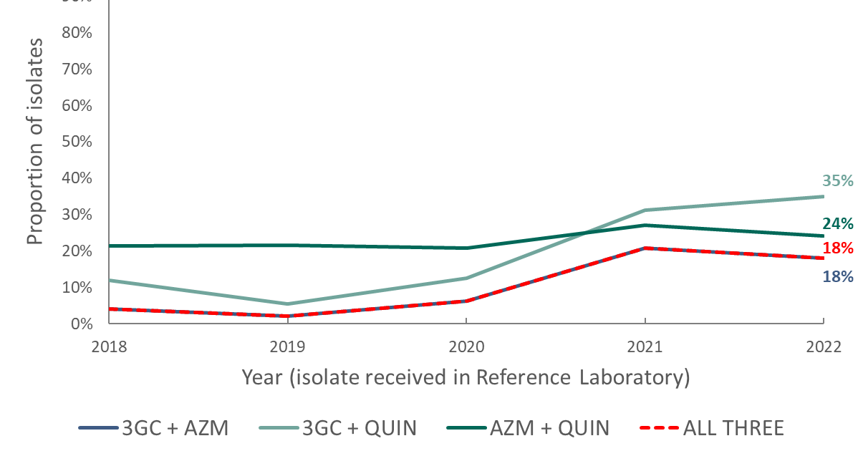
Antimicrobial resistant (AMR) shigellosis in Ireland, 2018-2022
Genotypic AMR testing in National Salmonella, Shigella and Listeria Reference Laboratory since 2018
Predicted 3rd generation cephalosporin resistance increasing (12% in 2018 to 36% in 2022)
Predicted azithromycin resistance stable (29% in 2018 to 36% in 2022)
Predicted quinolone resistance relatively stable (63% in both 2018 and 2022)
Isolates displaying resistance determinants to all three classes of antimicrobials increasing (4% in 2018 to 18% in 2022)
many also had resistance determinants for trimethoprim/sulfamethoxazole or ampicillin (only 5 resistant to all)
3GC=predicted 3rd generation cephalosporin resistance; AZM=predicted azithromycin resistance; QUIN=predicted quinolone resistance. Resistance is predicted based on the presence of any resistance determinants to the indicated antimicrobial class.
Data source: National Salmonella, Shigella and Listeria Reference Laboratory

Slide 8
Four current clusters of concern, 2018-2023
Four clonal groups of concern in 2023 upsurge of cases:
S. flexneri: SH19-007 and SH20-004
S. sonnei: SH19-005 and SH22-001
Majority in these clusters are adult males
4 chains of transmission among gbMSM in Ireland (although overlap is possible)
SH19-007 is the most extensive chain of transmission
The 3 other clonal groups are more associated with antimicrobial resistance to clinically relevant antimicrobials
Note: Cluster codes are National Reference Laboratory designations
Data source: National Salmonella, Shigella and Listeria Reference Laboratory

Slide 9
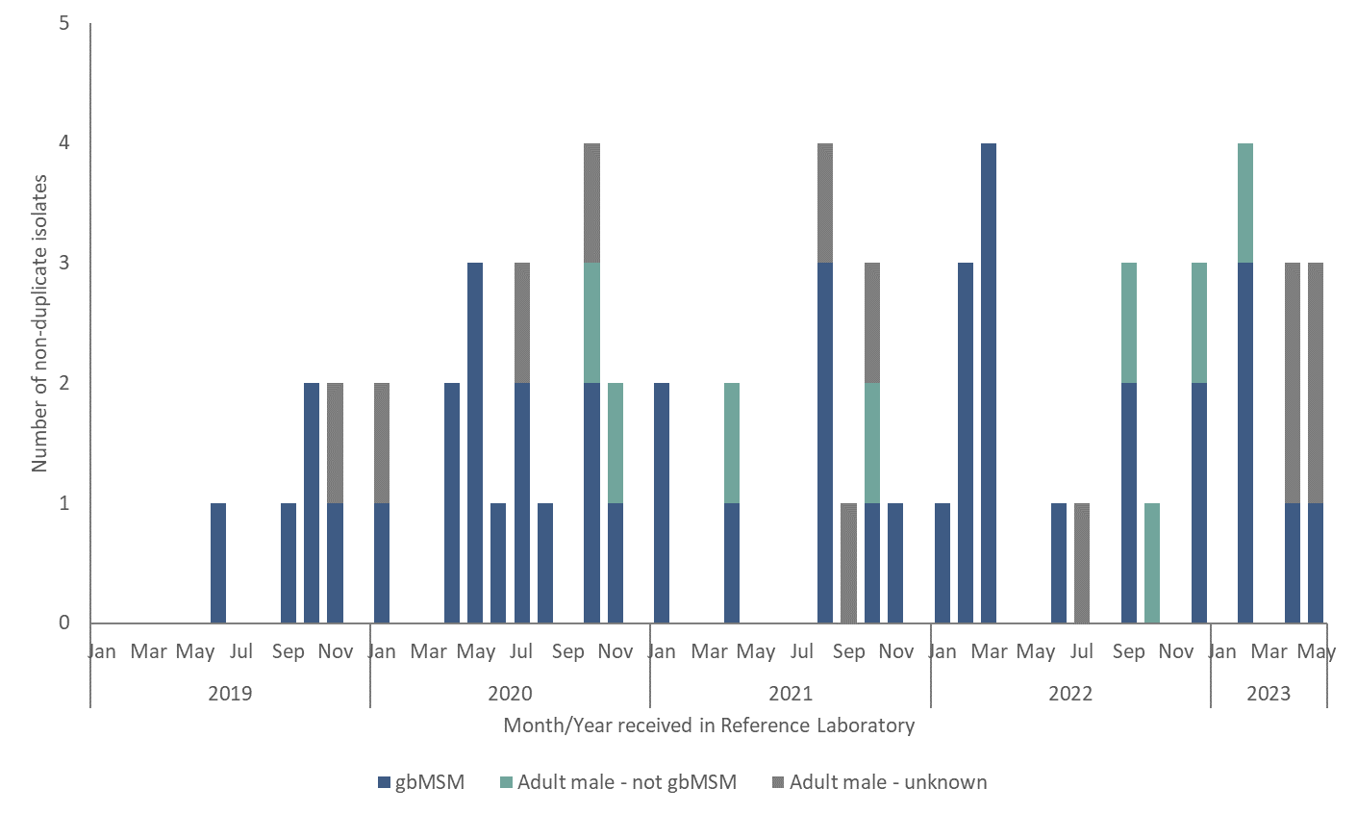
S. flexneri SH19-007 by sexual orientation 2019-2023
Summary:
64 cases - all adult males
44 gbMSM
12 unknown
8 not gbMSM
Most representatives of this clonal group do not have resistance determinants to ceftriaxone, azithromycin or fluoroquinolones
One had a blaCTX-M-14 gene (ESBL)
Eight had some resistance determinants for azithromycin
Note: Unknown gbMSM status may be because status was not reported on CIDR OR because it was not possible to match CIDR event and Laboratory ID
Data source: Computerised Infectious Diseases Reporting system (CIDR) and National Salmonella, Shigella and Listeria Reference Laboratory

Slide 10
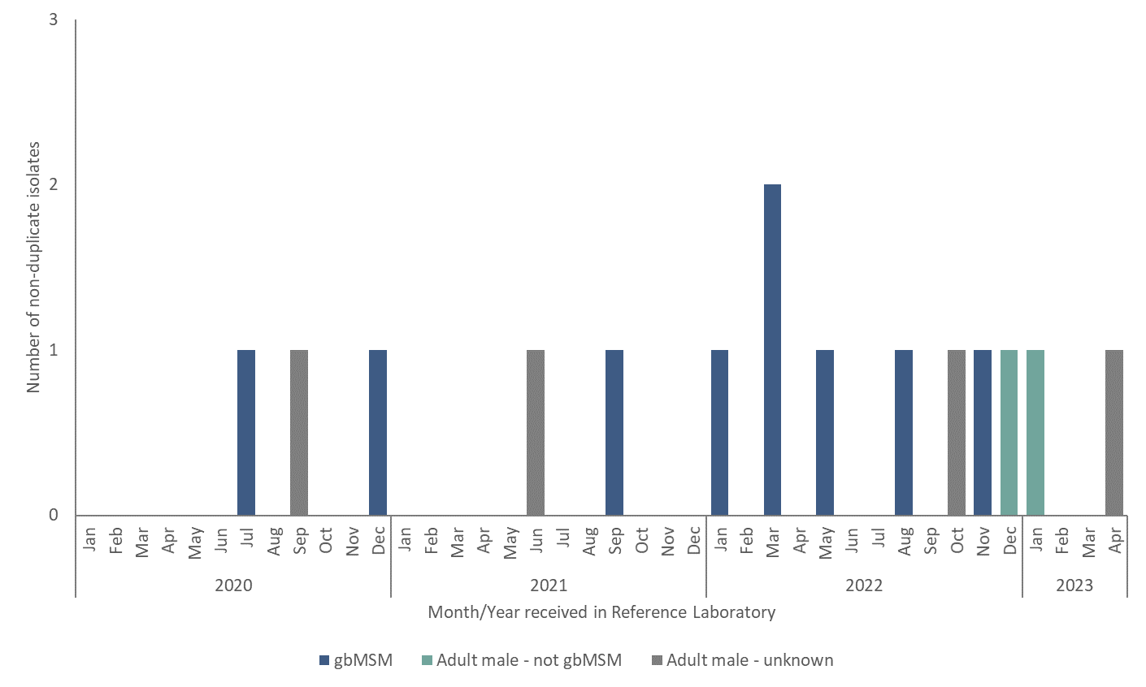
S. flexneri SH20-004 by sexual orientation, 2020-2023
Summary:
15 cases - all adult males
9 gbMSM
4 unknown
2 not gbMSM
60% (n=9) have resistance determinants for all 3 of ceftriaxone, azithromycin and fluoroquinolones (CAF resistance)
20% (n=3) for ceftriaxone and fluoroquinolones
20% (n=3) for fluoroquinolones alone
Note: Unknown gbMSM status may be because status was not reported on CIDR OR because it was not possible to match CIDR event and Laboratory ID
Data source: Computerised Infectious Diseases Reporting system (CIDR) and National Salmonella, Shigella and Listeria Reference Laboratory

Slide 11
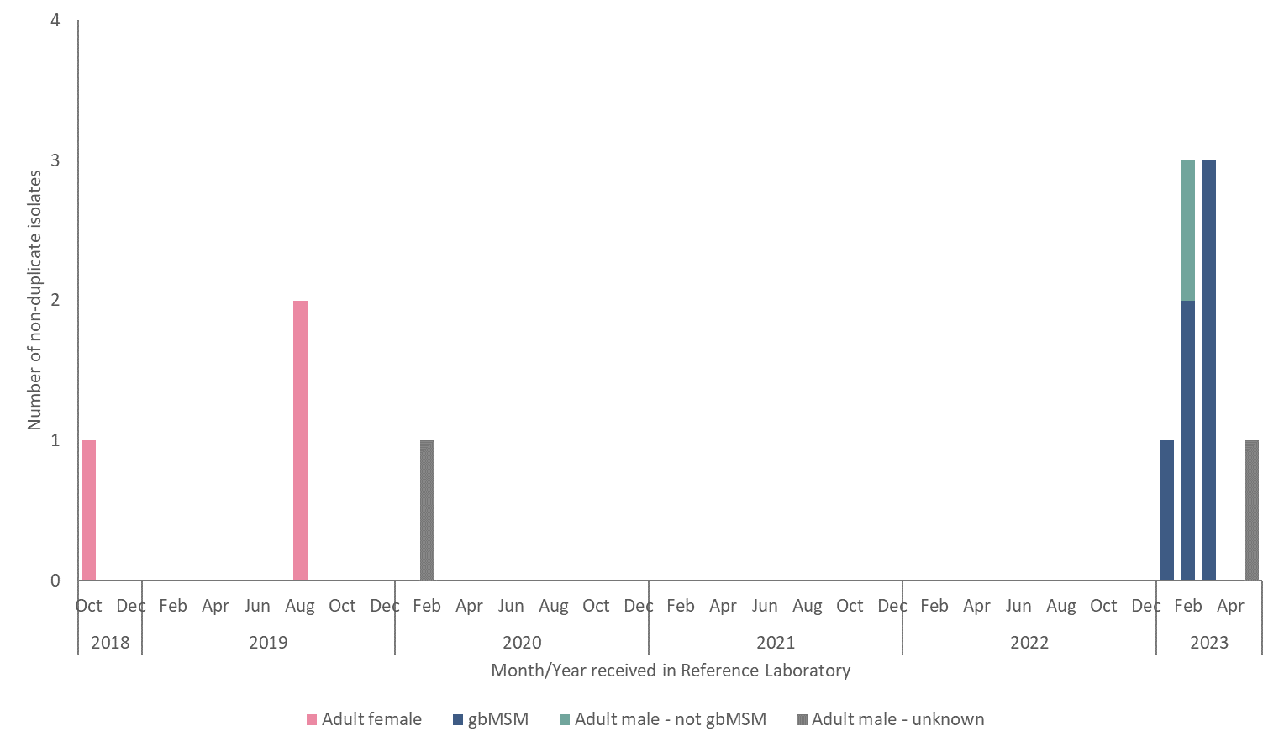
S. sonnei SH19-005 by sex and sexual orientation, 2018-2023
Summary:
12 cases
3 adult females in 2018/19 associated with travel to USA and South America
9 adult males not associated with international travel
6 gbMSM; 2 unknown, 1 not gbMSM
This cluster frequently carries a resistance determinant for fluoroquinolones (qnrB19)
No resistance markers for ceftriaxone or azithromycin
Note: Unknown gbMSM status may be because status was not reported on CIDR OR because it was not possible to match CIDR event and Laboratory ID
Data source: Computerised Infectious Diseases Reporting system (CIDR) and National Salmonella, Shigella and Listeria Reference Laboratory

Slide 12
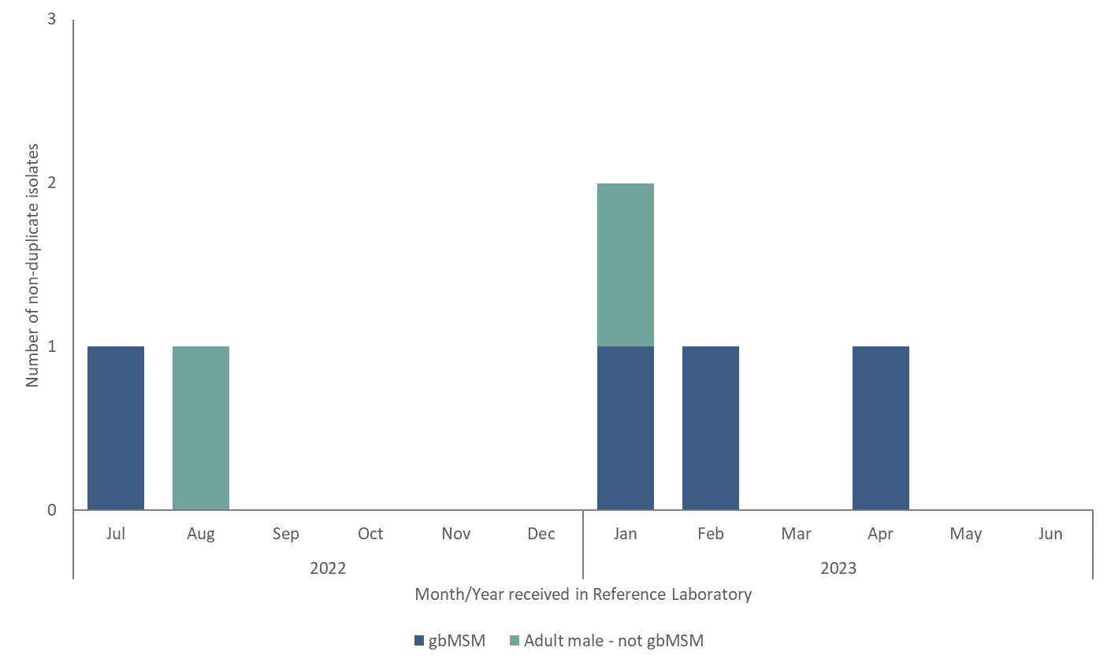
S. sonnei SH22-001 by sexual orientation, 2022-2023
Summary:
6 cases - all adult males
4 gbMSM
2 not gbMSM
One case reported international travel to middle east
All isolates carry resistance determinants for ceftriaxone and fluoroquinolones
No resistance markers for azithromycin
Match to international cluster reported in EU and USA
Note: Unknown gbMSM status may be because status was not reported on CIDR OR because it was not possible to match CIDR event and Laboratory ID
Data source: Computerised Infectious Diseases Reporting system (CIDR) and National Salmonella, Shigella and Listeria Reference Laboratory

Slide 13
Response
National multisectoral Outbreak Response Team in place
Clinicians, Public Health, microbiologists, NGO partners, HSE communications, clinical leads for AMR and Sexual Health, national HIV/STI and gastroenteric and zoonotic disease teams
Clinical review of treatment guidance, in light of AMR
Risk communication and community engagement
Enhanced surveillance, PH guidance for management of shigella in adult males

Slide 14
Response: New treatment guidance (22.6.2023)
Coordinated by National Clinical leads for Sexual Health, Antimicrobial Resistance and Director of National Salmonella, Shigella and Listeria Reference laboratory
Based on AMR surveillance information
New treatment recommendations
First line treatment for adult males hospitalised with shigella
Use carbapenem such as meropenem, pending results on susceptibility to azithromycin, ceftriaxone or fluoroquinolone
Non hospitalised adult males with confirmed shigellosis
Treat with oral azithromycin 500mg daily for 3 days
https://www.hpsc.ie/a-z/gastroenteric/shigellosis/guidancepublications

Slide 15
Response: Enhanced surveillance and PH response
PH guidance for management of shigella in adult males reviewed and updated
Existing surveillance data limited. Decision to enhance surveillance for 6 months on pilot basis, with more detailed sexual exposure information
Sexual exposure sex between men? If yes
Test for other STIs
Check for symptoms in contacts
Advice re prevention of transmission and sexual practices (none until 7 days post resolution of symptoms)
Available at https://www.hpsc.ie/a-z/gastroenteric/shigellosis/surveillanceforms/

Slide 16
Response: Risk Communication and community engagement
gbMSM community partners on outbreak response team
Partnership working with Health Service communications team and Public Health.
Funding provided for:
Targeted communications raising awareness on multiple social media platforms
Outreach in venues
Presence at PRIDE
Article in Gay Community News
https://gcn.ie/man2man-campaign-shigella-ireland/

Slide 17
Technical Notes
These slides may be copied and reproduced, provided HPSC is acknowledged. Suggested citation: HSE-Health Protection Surveillance Centre. Recent increase in drug resistant shigella among gay, bisexual and other men who have sex with men (gbMSM) in Ireland: Outbreak Response. Dublin: HPSC; 2023.
Data were extracted from CIDR on 07/06/2023 and were correct at the time of publication.
Data are provisional and subject to ongoing review, validation and update. As a result, figures in this report may differ from previously published figures or figures reported in the future.
As this is an ongoing outbreak, data presented on cases and clusters will be subject to further updates.

