Slide 1
Haemophilia and the National Hepatitis C Database Irish Haemophilia Society Conference, Dunboyne, September 2016 Niamh Murphy & Dr Lelia Thornton

Slide 2
Timeline of haemophilia treatment and hepatitis C and HIV infection
1960s
1980s
1990s
1967 onwards: Factor concentrates available
1970s
Freeze dried powdered concentrates available
1991: Commercial blood test for hepatitis C, start of blood screening for hepatitis C
Home use possible
improved life expectancy
No anti-viral inactivation
1983: HIV virus isolated
1989: solvent detergent inactivation of hepatitis viruses in factor concentrates
1985: commercial blood test for HIV, start of blood screening
Commercially fractionated factor concentrates from large pooled donor used
1989: hepatitis C virus isolated
1986: heat inactivation of HIV in factor concentrates

Slide 3
Hepatitis C and HIV Infection
At least 225 people with haemophilia and other inherited bleeding disorders became infected with hepatitis C in Ireland
106 became infected with HIV
The Irish Haemophilia Society estimates that there were approximately 250 people with severe haemophilia in Ireland at the time
Almost all infected with hepatitis C
More than 40% infected with HIV

Slide 4
Consequences of hepatitis C infection
Initially thought to cause mild disease, later found not to be the case
Chronic infection can cause cirrhosis, hepatocellular carcinoma (HCC), liver failure and death
5%-20% develop cirrhosis after 20-30 years
Of those with cirrhosis, each year approximately 4% progress to decompensated liver disease and 2-3% develop HCC
Disease progression is faster in males, people who were older at infection, those who are co-infected with HIV or hepatitis B and those who consume large amounts of alcohol or who are obese

Slide 5
Hepatitis C database
National hepatitis C database set up by HPSC in 2004 to collect information on people infected with hepatitis C through blood or blood products in Ireland, including:
people with haemophilia or other inherited bleeding disorders
women infected through anti-D immunoglobulin
people infected through blood transfusions/renal dialysis
Hepatitis C infection: one or more positive antibody or RNA results
Only patients who consented and deceased patients are included
No names or addresses are recorded
Project approved by ethics committees of the eight hospital hepatology units and the office of Data Protection Commissioner

Slide 6
Main objectives of the hepatitis C database
Describe hepatitis C disease progression
Describe treatment uptake and outcomes
Describe the effect of host and virus factors on disease progression - gender, age, source of infection, BMI, alcohol consumption, hepatitis C genotype and co-infection with HIV or hepatitis B
To provide information for the planning of future health services

Slide 7
What has been done so far?
Eligible patients were identified by hepatology units
Information leaflets and consent forms sent by hepatology units
HPSC database research nurse collected data from the medical records of consenting and deceased patients
Data collected on five occasions between 2005 and 2014
Includes data from the time of first attendance at the hepatology unit up to the end of 2013

Slide 8
Database participation: numbers and % of total eligible population

Slide 9
Consent status for people with haemophilia
225 people with haemophilia and other inherited bleeding disorders identified as eligible for the database
165 included
Refusal rate low: of the 60 not included only 8 refused. 49 were non responders and charts were missing for 3 deceased patients
Deceased people were automatically included if they had not refused participation while alive
Deceased people and older people were more likely to be included in the database – likely to have resulted in a bias towards worse outcomes

Slide 10
Estimated year of infection for participants infected through blood clotting factors
Notes:
If the actual year of infection was missing, the date each patient first received factor concentrates was used as a proxy for date of infection.
Most people were infected in the 1970s and early to mid 1980s
The peak infection period was the mid 1970s

Slide 11
Hepatitis C RNA status (n=165)
Notes:
Never chronically infected: no cirrhosis, no HCC, no signs of serious liver disease, no liver-related deaths – excluded from the rest of the analysis
There were 37 people with no RNA results – all of these patients had died between 1988 and 1997
Based on their clinical history, most were likely to have been chronically infected with HCV
These patients were included with those who had tested RNA positive and were therefore chronically infected for the rest of the data presented here

Slide 12
Age and sex (n=143)
Characteristic | Median | Range
Age at infection | 14 | 0-59
Age at end of follow up | 45 | 12-81
Vast majority of participants were male – 94%, n=134
Notes:
Most haemophiliacs were infected with HCV as children or teenagers and were in their 40s when last followed up
The median duration of infection at the end of follow up was around 30 years

Slide 13
Hepatitis C genotype (n=92)
Notes:
Hepatitis C genotype available for 92 participants

Slide 14
Alcohol consumption (highest reported level) (n=104)
Notes:
Over one third - 35% consumed alcohol in excess of the recommended limits – 36 people
19 moderately high intake
17 high alcohol intake

Slide 15
HIV co-infection
47% (n=67) of chronically HCV infected database participants were co-infected with HIV
Highly active antiretroviral therapy (HAART) was introduced into Ireland in 1996 – no effective treatment for HIV before this
Almost half (46%, n=31) of HIV co-infected database participants died before HAART became available in Ireland
Death certificates were available for 28 of these participants
57% (n=16) died from HIV/immunodeficiency/non-hodgkin’s lymphoma
18% (n=5) died from haemophilia
11% (n=3) died from liver-related causes
14% (n=4) died from other causes (incl 2 pneumonia and 1 septicaemia)
Notes:
Haemophilia accounted for a much lower percentage of deaths after 1996 (around 5%) – likely that some HIV-related deaths were coded to haemophilia.
Duration of Hepatitis C infection at the end of follow up was about 20 years for HIV positive participants who died prior to HAART in Ireland. Whereas the median duration of hepatitis C infection was 36.5 years by the end of follow up for HIV positive participants who were alive when HAART became available in Ireland and 31 years for HIV negative database participants
To look at the longer term of effects of hepatitis C by HIV status, we compared the HIV negative participants to the HIV positive participants who were alive once HAART was introduced into Ireland

Slide 16
Hepatitis B co-infection
12% (n=16) of database participants were also chronically infected with hepatitis B
This varied by HIV status
25% (n=7) of HIV positive participants who died prior to 1996
15% (n=5) of HIV positive participants who were alive in 1996
6% (n=4) of HIV negative participants

Slide 17
Liver-related outcomes by HIV status
 | HIV positive, alive in 1996 (n=36, 25%) |  | HIV negative (n=76, 53%)
 | Num | % | Num | %
Signs of serious liver disease | 23 | 63.9 | 18 | 23.7
Hepatocellular carcinoma | 4 | 11.1 | 8 | 10.5
Cirrhosis | 11 | 30.6 | 12 | 15.8
Deceased | 16 | 44.4 | 26 | 34.2
Liver-related death | 7 | 46.7 | 10 | 40
HIV/immundeficiency/NHL | 5 | 33.3
Haemophilia | 2 | 13.3 | 4 | 16
Other | 1 | 6.7 | 11 | 44
Missing death certs | 1 |  | 1
Notes:
Signs of serious liver disease include HCC and cirrhosis in addition to varices, ascites, portal hypertension, encephalopathy, hepatomegaly, and splenomegaly

Slide 18
Proportion of participants without cirrhosis

Slide 19
Treatment for hepatitis C
Treatment uptake did not vary by HIV status when HIV positive participants who were alive in 1996 compared to HIV negative participants – 53% (n=59) (37% in Anti-D 1977 group)
Treatment response was slightly lower for HIV positive compared to HIV negative participants but this difference was not statistically significant due to small numbers
59% (n=10) of HIV positive participants achieved SVR compared to 68% (n=25) of HIV negative participants
Treatment response was not yet available for 5 further patients at the end of follow up, but all were RNA negative on last test
Only 7% of patients stopped treatment early (26% anti-D group)

Slide 20
Sustained virological response by genotype and treatment type

Slide 21
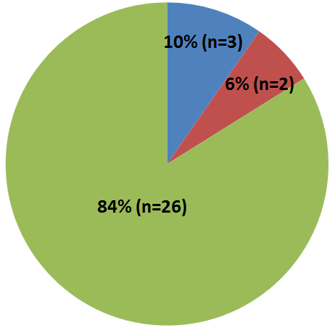
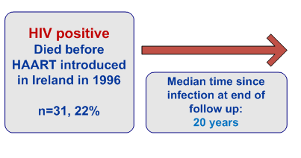
Final Liver related status HIV positive patients who died prior to 1996 (pre-HAART)

Slide 22
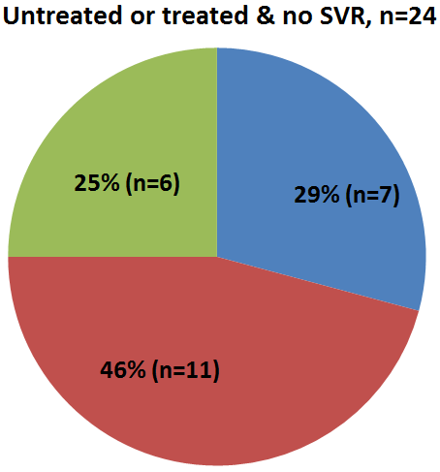
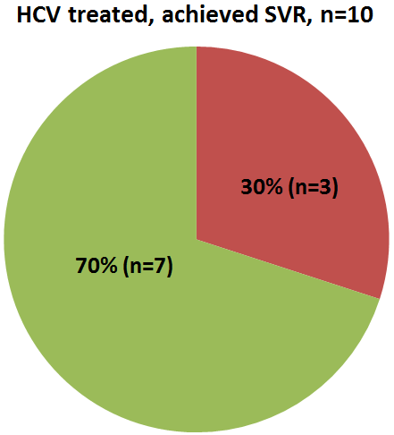
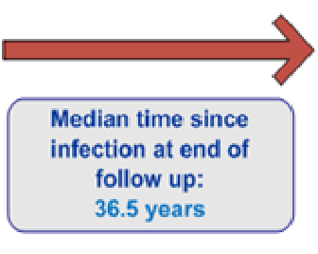
Final Liver related status HIV positive patients alive in 1996, n=34
Notes:
36 HIV positive patients alive in 1996, but no treatment outcome available for 2 – awaiting treatment response at end of follow up

Slide 23
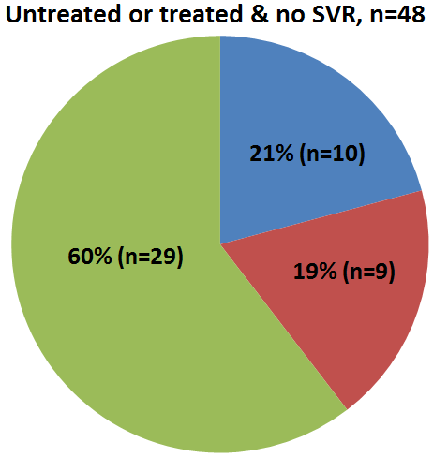
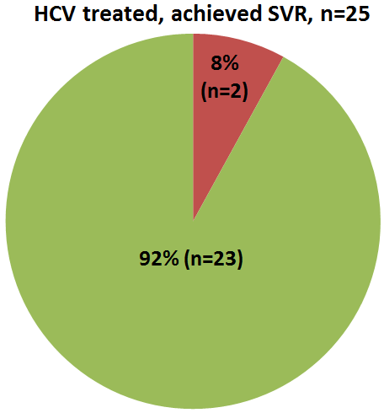
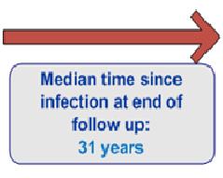
Final Liver related status HIV negative patients, n=73
Notes:
76 HIV negative participants but treatment response not available for 3 – awaiting treatment response at end of follow up

Slide 24
Cox regression: factors associated with rate of cirrhosis
Exposure | Rate cirrhosis per 1000 person years (95% CI) | Adjusted hazard ratio | p | 95% confidence interval
Hepatitis C status
Past chronic infection | 0.6
Current chronic infection | 10.7 | 15.7 | 0.008 | 2.04-120.69
Hepatitis B status
Never infected | 4.1
Chronically infected | 17 | 20.2 | <0.001 | 5.05-81.15
Ever had high alcohol intake
No | 5.3
Yes | 11.5 | 7.2 | 0.002 | 2.06-24.97
Age at infection
<20 years | 3.8
20-29 years | 9.8 | 2.8 | 0.058 | 0.97-8.18
30+ years | 11.3 | 4.6 | 0.011 | 1.42-14.72

Slide 25
Final comments
This data shows the progression of hepatitis C infection in the 30 year period up to the availability of the latest generation of DAA drugs for hepatitis C
After 30 years of infection more than a third of this population had developed signs of serious liver disease or had died from liver-related causes
However, outcomes have significantly improved since the early days of patients dying from HIV and initially poor treatment options for hepatitis C
Overall, treatment uptake and responses were good in this group
All remaining chronically infected patients, along with other state infected groups, should be offered treatment with the new highly effective DAA drugs by the end of 2017

Slide 26
Acknowledgements and thanks
Database participants
Medical, nursing and administrative staff in the hepatology units
Paula Flanagan - Research Nurse, HPSC
Margaret McIver – Surveillance Assistant, HPSC
Brian O’Mahony, Irish Haemophilia Society

