Slide 1
National Hepatitis C Database
National Hepatitis C Database
Dr Lelia Thornton
Health Protection Surveillance Centre
December 2012

Slide 2
Background
The National Hepatitis C Database was set up in 2004 in association with eight specialist hepatology units
Any person (alive or dead) who contracted HCV infection through the administration of blood or blood products within the state is eligible to be included
4th Round of data collection completed (contains data to 31st December 2009)

Slide 4
Hepatitis C RNA results for all participants and by source of infection

Slide 5
Distribution of hepatitis C genotypes by source of infection (n=722, genotype 4&5 omitted, n=4)

Slide 6
Summary of age at infection, age at end of latest follow-up, years since infection by source of infection
Source of infection and RNA status | Age at infection | Age at end of follow up | Duration of infection (years since infection)
 | Median (range) | Median (range) | Median (range)
Anti-D | 28 (16-44) | 57 (26-76) | 32 (4-45)
Anti-D 1977-1979 | 28 (17-44) | 58 (33-76) | 32 (17-33)
Anti-D 1991-1994 | 30 (18-39) | 46 (26-56) | 16 (4-18)
Transfusion or renal | 32 (0-77) | 61 (16-91) | 23 (1-48)
Clotting factors | 13 (0-59) | 42 (12-81) | 27 (8-50)

Slide 7
Distribution of the highest reported alcohol consumption by gender for participants who became chronically infected (where data available, n=761, 93%)

Slide 8
Liver related outcomes for participants who are currently RNA positive

Slide 9
Cirrhosis
137 ever chronically infected participants had developed cirrhosis*
86 (14.5%) were female and 51 (23.2%) were male
Median duration of RNA positivity at the estimated date of cirrhosis was 24 years
Median age at cirrhosis was 53 years
There was no cases of cirrhosis in those who never developed chronic HCV infection
After RNA status, alcohol consumption was the biggest determinant of risk of cirrhosis
Notes:
*5 participants with cirrhosis had no RNA results in their charts

Slide 10
Hepatocellular carcinoma (HCC)
32 ever chronically infected participants had developed HCC
Prevalence was significantly higher in males (n=20, 9%)
Median duration of infection at time of HCC diagnosis was 27.5 yrs and the median age at diagnosis of HCC was 63 yrs
The median time from estimated date of diagnosis of cirrhosis to estimated date of diagnosis of HCC was three years
Notes:
*2 patients with HCC had no RNA results in their charts

Slide 11
Comparison of rates of cirrhosis

Slide 12
Summary of main outcomes by hepatitis C RNA status for all participants (excludes n=50 with no RNA results)
Outcomes | All (n=1316) |  | Ever chronically infected * (n=815) |  | Never chronically infected † (n=451)
 | Num | % | Num | % | Num | %
Signs of liver disease | 187 | 14.2 | 175 | 21.5 | 5 | 1.1
Cirrhosis | 142 | 10.8 | 137 | 16.8 | 0 | 0.0
Liver tumours or HCC | 34 | 2.6 | 32 | 3.9 | 0 | 0.0
High fibrosis score on biopsy ‡ | 167 | 12.7 | 160 | 19.6 | 4 | 0.9
Deceased | 212 | 16.1 | 145 | 17.8 | 26 | 5.8
Died from liver disease § | 55 | 4.2 | 45 | 5.6 | 2 | 0.4

Slide 13
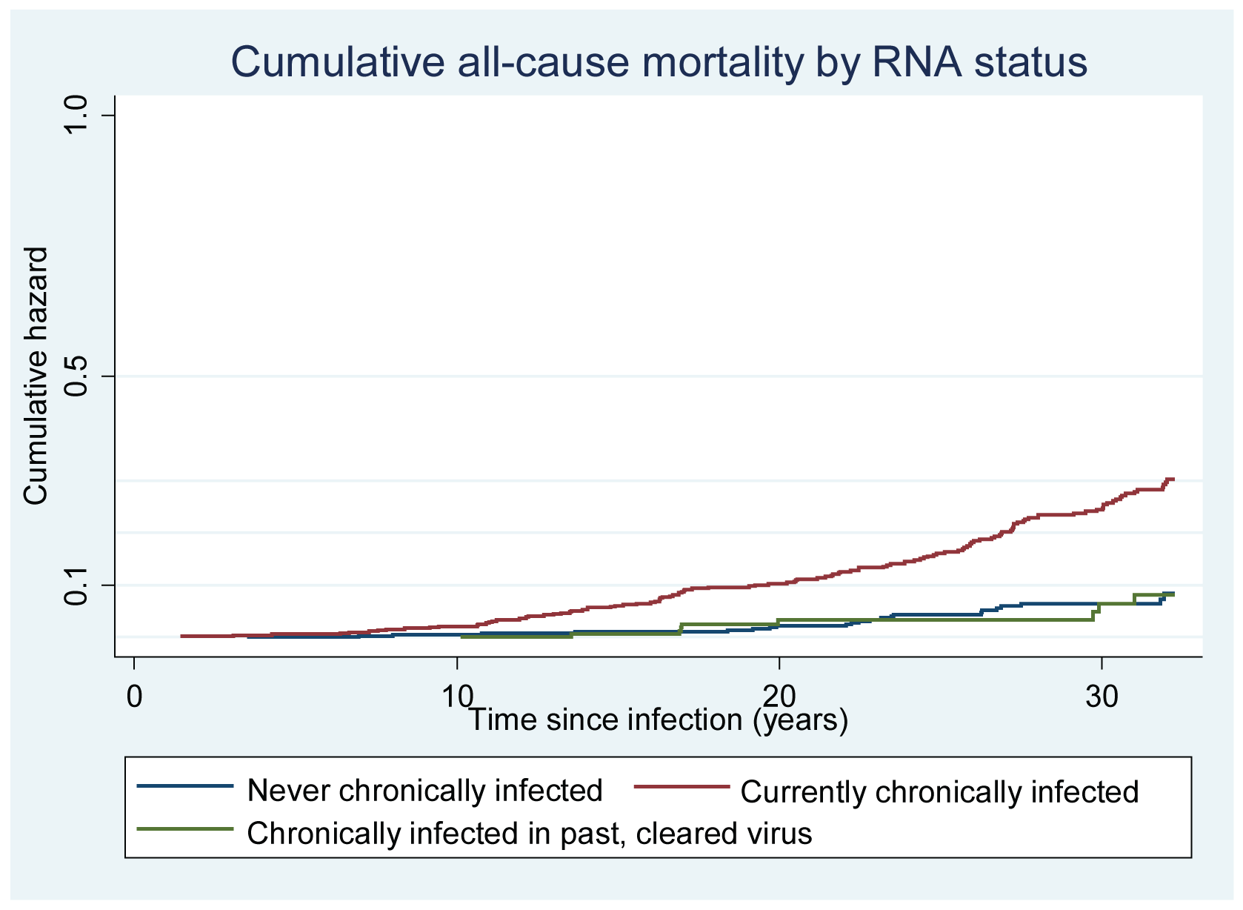
Comparison of all-cause mortality rates

Slide 14
Comparison of liver-related mortality rates

Slide 15
Changes in the prevalence of all cause mortality and liver-related outcomes for chronically infected participants since baseline data were collected

Slide 16
Factors associated with severe liver disease in chronically infected participants-logistic regression model including gender (n=727)
Factors associated with having severe liver disease (including Gender n=727) | Odds Ratio | P-value | 95% Confidence interval
Alcohol consumption
Non drinker/within recommended limits/moderately high | 1 | Reference | Reference
High (>40 units per week or alcohol abuse in chart) | 5.6 | <0.001 | 3.02 - 10.52
Age at end of latest follow-up
<50 years | 1 | Reference | Reference
50 to 64 years | 2.7 | <0.001 | 1.60 - 4.55
65+ years | 3.7 | <0.001 | 2.11 - 6.53
Gender
Female | 1 | Reference | Reference
Male | 2.8 | <0.001 | 1.83 - 4.37
Genotype
Genotype 1 | 1 | Reference | Reference
Genotype 2 | 0.9 | 0.762 | 0.35 - 2.14
Genotype 3 | 2.2 | 0.002 | 1.32 - 3.61
Duration of RNA positivity
<20 years | 1 | Reference | Reference
20+ years | 2.2 | 0.002 | 1.32 - 3.58

Slide 17
Factors associated with severe liver disease in chronically infected participants-logistic regression model including source of infection (n=725)
Factors associated with having severe liver disease | Odds Ratio | P-value | 95% Confidence interval
Alcohol consumption
Non drinker/within recommended limits/moderately high | 1 | Reference | Reference
High (>40 units per week or alcohol abuse in chart) | 5.5 | <0.001 | 2.97 - 10.36
Age at end of latest follow-up
<50 years | 1 | Reference | Reference
50 to 64 years | 2.2 | 0.003 | 1.31 - 3.66
65+ years | 2.6 | 0.001 | 1.47 - 4.55
Source of infection
Anti-D | 1 | Reference | Reference
Transfusion or renal | 2.8 | <0.001 | 1.85 - 4.35
Clotting factors | 2.1 | 0.025 | 1.09 - 3.93
Genotype
Genotype 1 | 1 | Reference | Reference
Genotype 2 | 0.6 | 0.286 | 0.25 - 1.51
Genotype 3 | 1.9 | 0.016 | 1.12 - 3.10
Duration of RNA positivity
<20 years | 1 | Reference | Reference
20+ years | 2.4 | 0.001 | 1.47 - 4.02

Slide 18
Treatment courses by type of treatment and percentage sustained virological response, 1992-2009

Slide 19
Percentage sustained virological response for treatment-naïve participants treated with combination therapy with Peg-IFN and RBN (n=124), by genotype and duration of therapy

